Slide 1
Transit Costs
Andrew Chu & Don Bookman

Slide 2
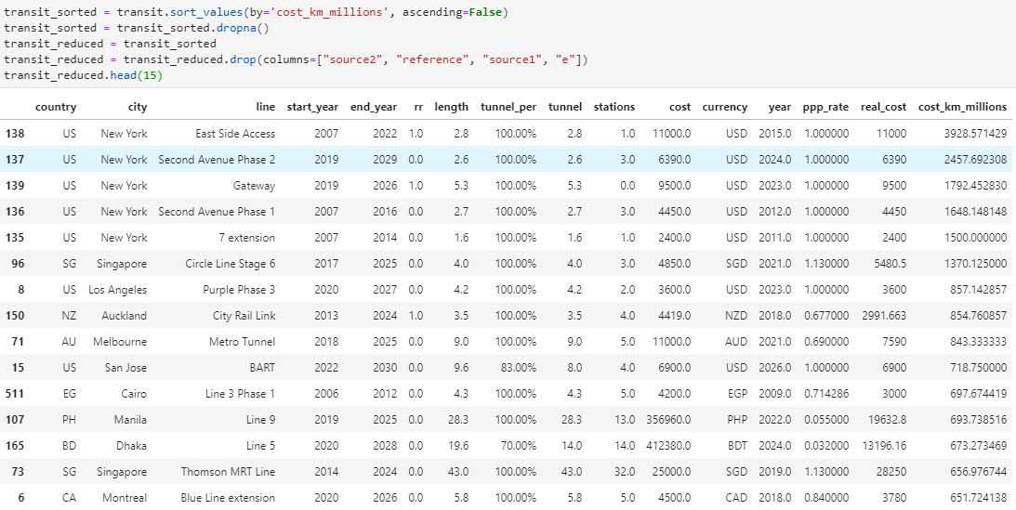
Introduction
Why do some transit lines cost more per kilometer than others?
Hypothesis - Transit lines cost more to build per kilometer in larger cities such as, New York and California because of the higher cost of living.

Slide 3
Dataset: TransitCosts.csv
Country - Country code. The abbreviations for each country.
City - The city that the transit line is being built in
Start_year - The year that the transit line construction was started
End_year - The year that the transit line construction ended (predicted or actual)
Cost - Cost in millions in local currency
Cost_km_millions - Cost/km in millions of USD
Length - Proposed length for the transit line in kilometers (km)
Tunnel - Total length of line completed in km as of the most recent update to the dataset
Stations - Number of stations where passengers can board/leave the transit line

Slide 4
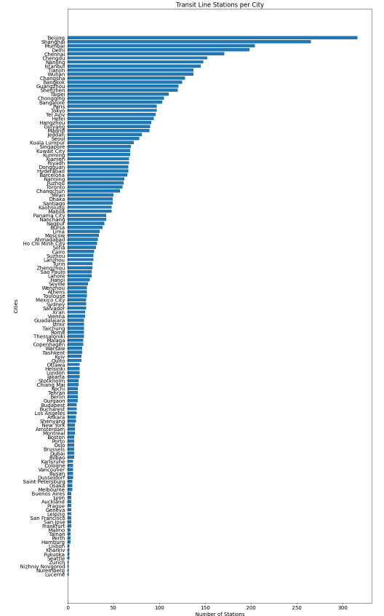
Data Analysis
Finding Connections
To kick off our research, we tried to find possible connections between variables that would support our hypothesis.
City and Stations
We thought the number of stations in each city could give us an idea of who the big spenders were going to be since more stations would mean more expenses and resources.
Realization
However, our graph was inconclusive and since there was a mix of large and small cities spread throughout the chart.

Slide 5
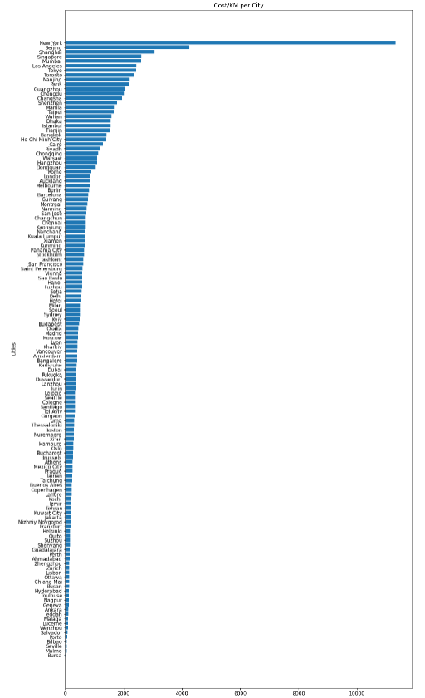
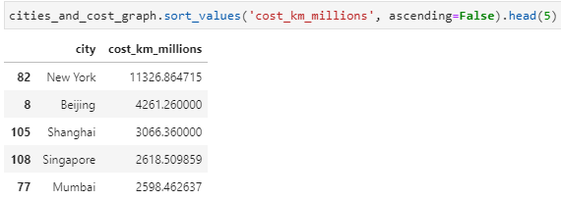
Intermediate Results
Cost/km per City
Moving on, we plotted the total cost of transit line projects in each city around the world and the biggest spender by far was New York.
This supported our hypothesis but we wanted to take a closer look at why New York was such an outlier in total costs.

Slide 6
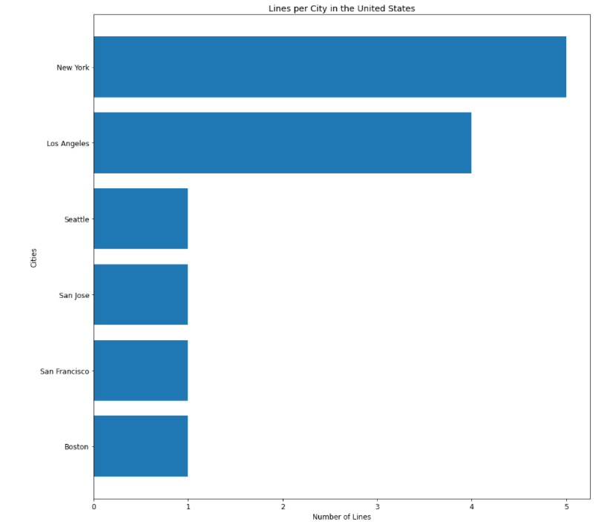
Intermediate Results Cont.
Lines per City in the United States
Next, we looked at how many lines there were in the American cities to gain some perspective on the data.
Moving forward, we kept in mind that the sample size of these cities was small and could possibly skew our findings.

Slide 7
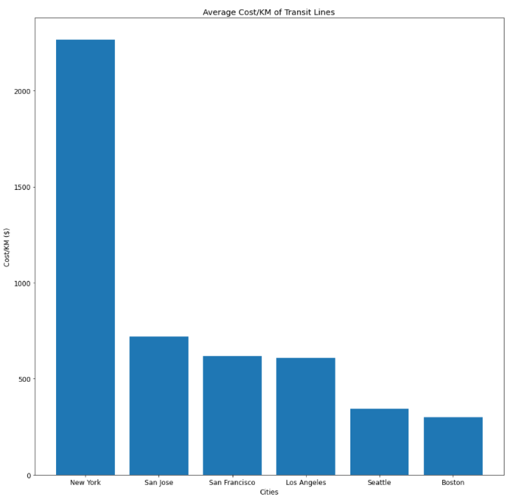
More Results
Average Cost/Km of Lines in the United States Cities
Next, we wanted to see the average cost of transit lines in these cities and found that New York greatly surpassed all the other cities.
This was surprising since we expected at least Los Angeles to be closer in cost to New York than it is.
New York - Overwhelming Leader in Transit Costs
Through research, we were able to find out that New York is the most expensive city in the United State to live in. This supports our hypothesis but the small sample size makes this connection somewhat weak.

Slide 8
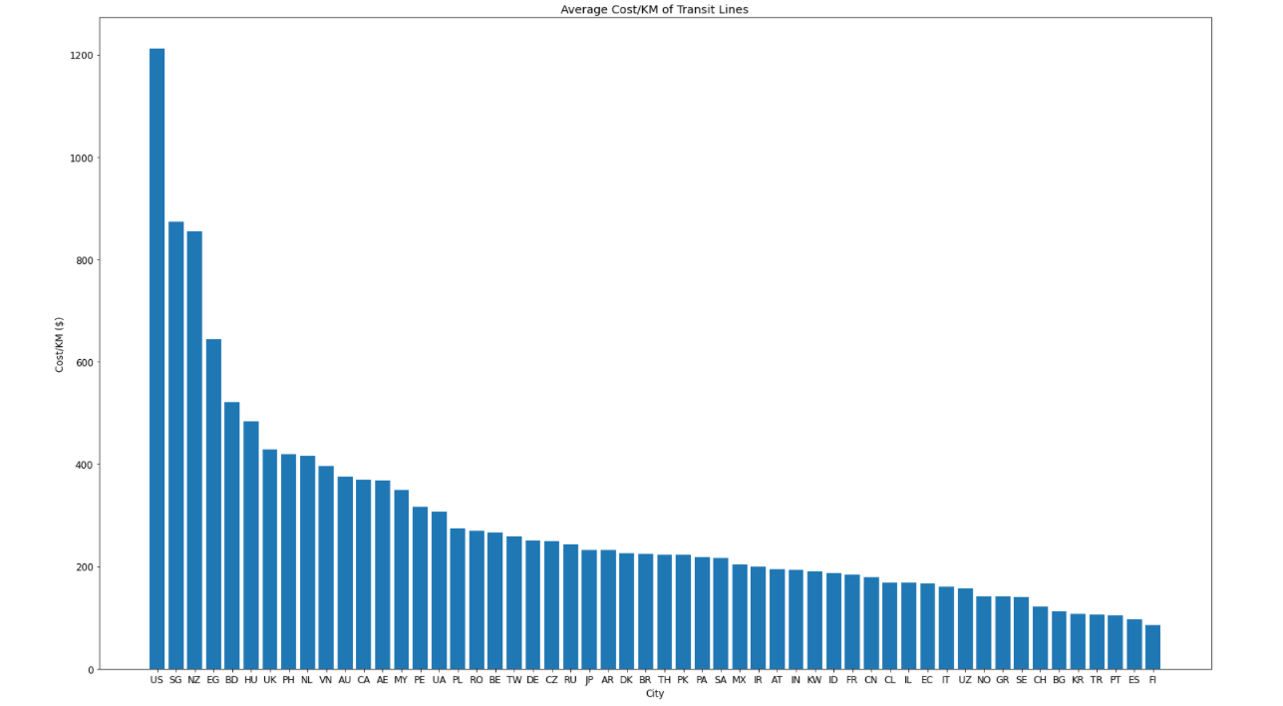
More Results Cont.
Average Cost/Km of Lines in Countries Around the World
Next we plotted the average cost/km per country on a global scale. This helped us better visualize the spread of different costs for transit lines.
Interestingly, the United States is unmatched in costs by any other country around the world. Also, Singapore, New Zealand, and Egypt were among the top spenders which leads us to believe that the environment may play a big role in the costs.

Slide 9
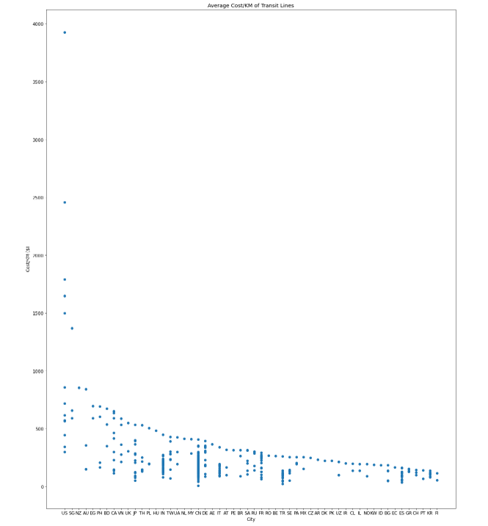
More Results Cont.
Average Cost/Km of Transit Lines
By plotting a scatter plot of the previous graph, we are able to see any major outliers as well as how tight the grouping is in each of the cities.
This helped us get an idea of how reliable certain countries were to the dataset since we could see how many entries each country had.
Concluding Thoughts
After this chart, we came to the conclusion that the cost of living in a city is not the best determining factor for the cost of transit lines. However, there is a strong possibility that the environment has a great effect on the cost of the transit line.

Slide 10
Obstacles/Desired Data
Obstacles
Determining what cities were considered big or expensive had to be left to us so there is room for bias in our results.
Some transit line projects were extensions or extremely small so it skewed the averages.
Not enough data
Desired variables
Cost of living in each city
Population
City and Country
Average Income

Slide 11
Questions?

